Slide 1
Chapter 15 – What is Matter?
Matter is anything that has mass and takes up space.

Slide 2
15.1 Classifying Matter
Matter can be divided into two categories:
Mixtures and Substances
Mixtures—contain more than one type of matter
Homogeneous Mixture—same throughout (kool-aid,
soft drink, broth)
Heterogeneous Mixture—not uniform throughout (vegetable soup, jello with fruit, granite)

Slide 3
Mixtures can be separated into different types of matter by physical means, such as:
Sorting
Filtering
Heating
Cooling
Substances cannot be separated by physical means. They can be separated by chemical means.

Slide 4
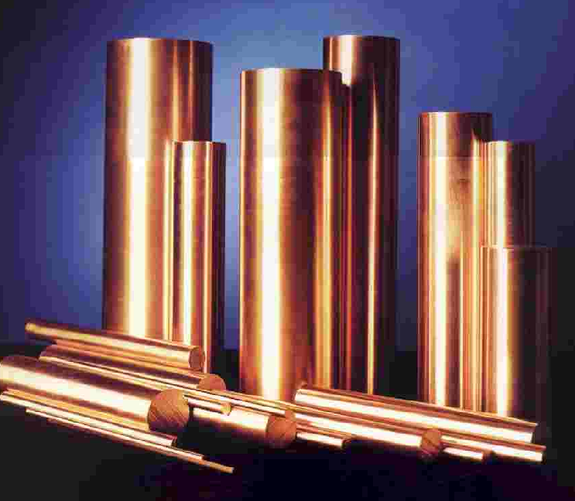
A substance can be either:
An element (Ag, Na, Cu) –these are only one kind of matter

Slide 5
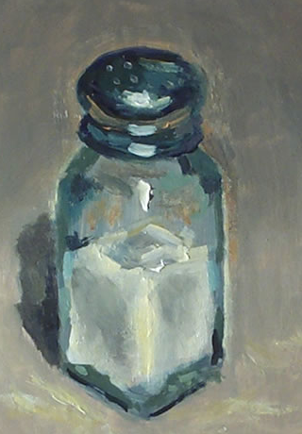
OR
A compound (NaCl, KBr, HF)—these are composed of two or more type of matter

Slide 6
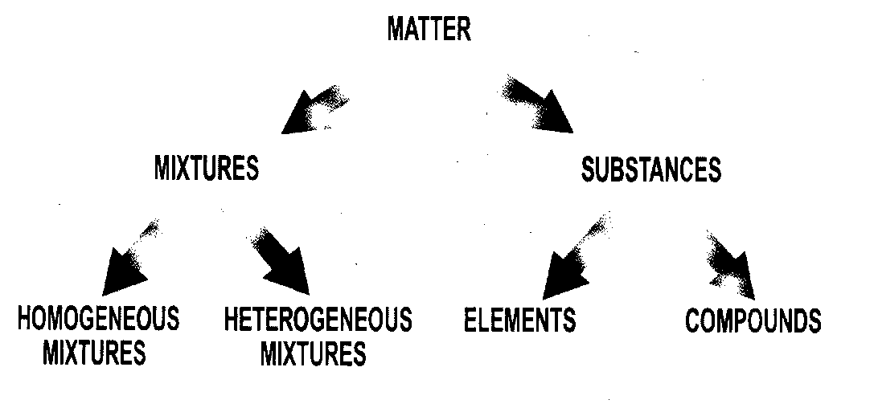
Here is how matter is differentiated.

Slide 7
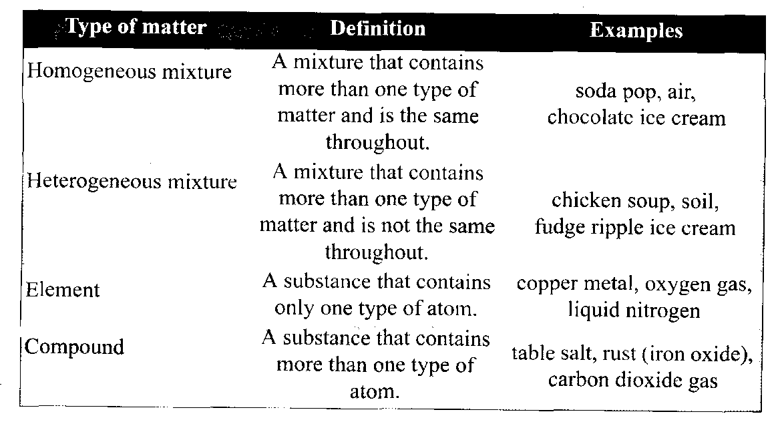
Summary of the types of matter

Slide 8
Solutions
A Solution is composed of two parts:
Solute- substance being dissolved, e.g. sugar, salt
Solvent- substance that the solute dissolves into
Water- most common solvent
Non-polar solvents such as acetone, mineral spirits, oil, fat, etc.

Slide 9
Solutions ctd…
All solutions are homogeneous mixtures whose dissolved solute particles are so small that:
They cannot be seen with a microscope
They never settle to the bottom or separate out
They constantly remain uniformly mixed throughout
Examples of solutions:
Vinegar
Sugar water
Non-carbonated fruit drinks

Slide 10
Colloids
A colloid is a type of solution in which the particles are larger but they are still not heavy enough to settle out
The particles in a colloid are large enough that they are able to partly impede the passage of light and scatter it- This is called the Tyndall Effect
Examples of Colloids: Paint, smoke, milk, coffee, fog
Stone Mountain- uses smoke to show up laser beams

Slide 11
Suspensions
A suspension is a heterogeneous mixture that is neither solution nor colloid
A suspension has particles large and heavy enough that they will always eventually settle out over time
Suspensions can also be separated out using filter paper
Examples: Muddy water- separates into muddy layer at bottom of container and clear water layer on top

Slide 12
15.2 Physical/Chemical Properties
Physical Properties
Any characteristic of a material that you can observe without changing the identity of the substances that make up the material (color, shape, size, density, melting point, and boiling point).
Appearance – describe the objects shape, color, and state of matter; diameter, mass
Behavior – attraction to a magnet, drawn out into wires (ductility); made into thin sheets (malleability); ability to flow (viscosity) );
Using Physical Properties to Separate – differences in color, shape, and size; pass a magnet through material that is magnetic.

Slide 13
Physical Changes
Physical Change (freezes, boils, evaporates, or condenses – it undergoes physical change). A change in size, shape, state of matter is called a physical change.
Distillation—separates substances in a mixture by evaporating liquid and condensing its vapor. Things can be separated by a difference in their boiling point.
-Desalination: seawater is distilled to remove its salt

Slide 14
Chemical Changes
A chemical change occurs when atoms of a compound are rearranged, combined or separated to form one or more new substances- this is an identity change
May be detected as change in color, odor, heating or cooling, smoke, gas bubbles, vapor, sound, or as a precipitate (new solid formed)- Ex: Nylon
The new substances typically have very different properties from the elements that make them up

Slide 15
Example: Sodium (Na) and Chlorine (Cl)
Sodium is a soft white metal that reacts violently when added to water; must be stored in oil long-term
Chlorine is a greenish, highly poisonous gas that when inhaled burns the lungs, causing hemorrhaging and a horrible, painful death from drowning in your own blood (used as a weapon in World War I; banned now)
These two elements react to form table salt, NaCl, a far less harmful substance vital to most living creatures’ health!!

Slide 16
Chemical changes can be used to separate one or more substances
Examples: Electrolysis- an electric current separates water into hydrogen and oxygen gases that can be collected
Jewelry Cleaner- chemical reaction removes tarnish, turning greenish black silver sulfide back into silver metal (Ag) and gases containing sulfur (SOx)

Slide 17
Law of Conservation of Mass
When chemicals react to form new substances, the chemicals themselves are never destroyed. Matter does not “disappear”, though it may appear to do so.
Example: burning wood- the chemical compounds comprising the wood react with oxygen at high temperatures; their atoms rearrange to form new substances (smoke and ashes).
- If you captured all the smoke and weighed it along with the ashes, they will weigh the same as the original piece of wood

