Slide 1
Chemical Reactions
Glencoe Physical Science
Chapter 21

Slide 2
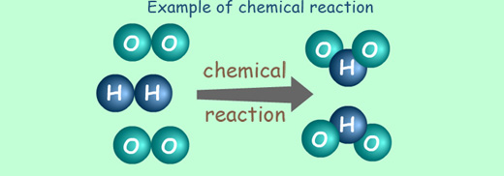
Chemical Reactions
A chemical reaction is a change in which one or more substances are converted into new substances
Original substances are called reactants
New substances are called products
Reactants → Products
2H₂ + O₂ → 2H₂O

Slide 3
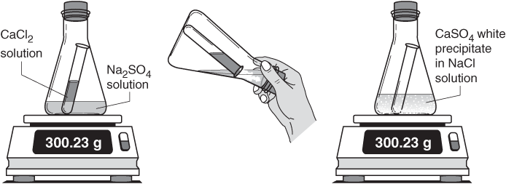
Review: Conservation of Mass
The Law of Conservation of Mass - matter is not created or destroyed, but is conserved
This means the total starting mass of all reactants equals the total final mass of all products

Slide 4
Chemical Equations
A chemical equation is a way to describe a chemical reaction using chemical formulas and other symbols.
Parts of a chemical equation: 6HgO _{(s)} → 6Hg _{(l)} + 3O₂ _{(g)}
Yield Sign
Reactants Products
Small numbers are subscripts
They tell you how many of that element you have
Large numbers in front of a compound are Coefficients
They tell you how many of that compound you have.
These small letters tell you whether it’s a solid (s), liquid (l), gas(g) or aqueous (ag)

Slide 5
Balancing Chemical Equations
To satisfy the Law of Conservation of Mass we must have balanced chemical equations.
A balanced chemical equation has the same number of atoms of each element on both sides of the equation.
Rules to follow:
Never change subscripts
Only adjusting the coefficients
Multiply the coefficient and the subscript to determine how many of an element you have. 5 H₂ = 10, it does not equal 7

Slide 6
How to balance an equation
Make a list of each element you have and how many you have on each side of the equation H₂ + O₂ → H₂O
Adjust your coefficients one at a time to balance your equation 2 H₂ + O₂ → H₂O
Check your work.
H = 2
O = 2
H = 2
O = 1
2
H = 4
O = 2
H = 4
O = 2

Slide 7
Try these on your own:
HgO → Hg + O₂
Fe + Cl₂ → FeCl₃
P + O₂ → P₂O₄
H₂ + N₂ → NH₃

