Slide 1
Classifying Chemical Reactions

Slide 2
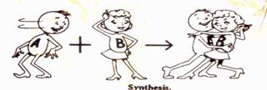
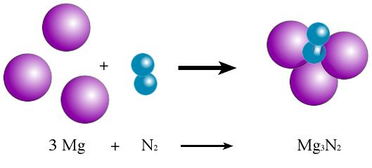
Synthesis Reactions
Two or more elements or compounds combine to make a more complex substance
A + B → AB
H₂ + O₂ → H₂O₂

Slide 3
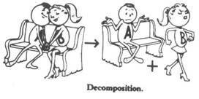
Decomposition Reactions
Compounds break down into simpler substances
AB → A + B
2H₂O → H₂ + O₂

Slide 4
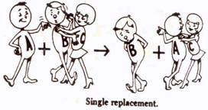
Single Replacement Reaction
Occurs when one element replaces another one in a compound
Also called Single displacement reaction
AB + C → AC + B
Fe+ HCl → FeCl + H

Slide 5
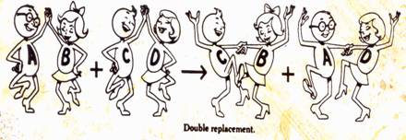
Double Replacement Reaction
Occurs when different atoms in two different compounds trade places
Also called double displacement reaction
AB + CD → AD + CB
KCl + H₂O → K₂O₄ + HCl

Slide 6
What type of reactions are these?
Reaction | Type
Cu + 2AgN₃ → CuN₂ + 2Ag
FeS + HCl → FeCl₂ + H₂S
8 Fe + S₈ → 8 FeS
2 KCl → 2 K + Cl₂
NiCl₂ → Ni + Cl₂
Zn + HCl → ZnCl + H₂
Single Replacement
Double Replacement
Synthesis
Decomposition
Decomposition
Single Replacement

