Slide 1
Energy
Chapter 4

Slide 2
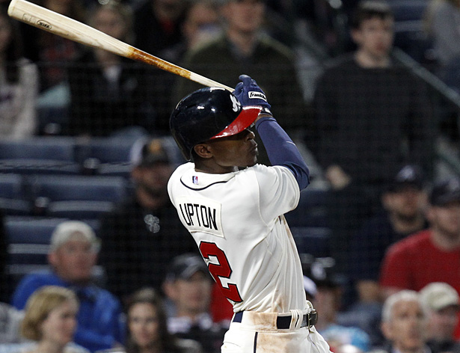
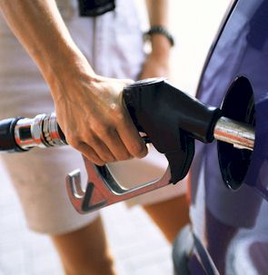
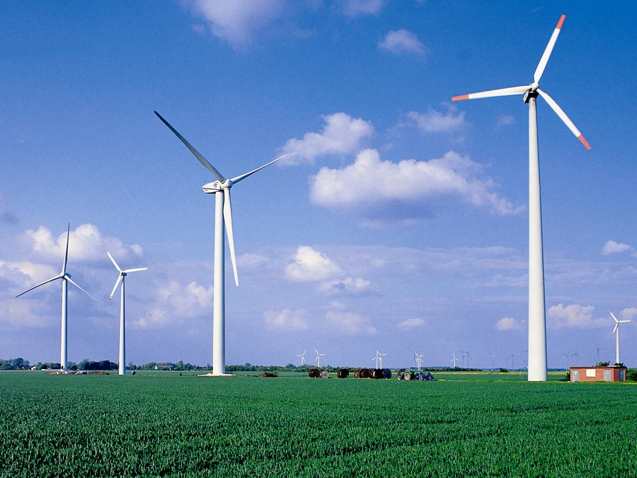
What is Energy?
Every change that occurs requires energy
Energy is the ability to cause change

Slide 3
Kinetic Energy
Kinetic energy is the energy a moving object has because of its motion
It depends on the objects mass and speed
Kinetic energy (in joules) = ½ mass (in kg) x [speed (in m/s)]²
KE = ½ mv²
Joule is the unit for energy

Slide 4
Solving for Kinetic Energy
A jogger with a mass of 60 Kg is moving at a speed of 3.0 m/s. What is the jogger’s kinetic energy?
m = 60 kg
Speed = v =3.0 m/s
KE= ½ mv²
KE= ½ x 60 x 3.0² = 270
Don’t forget your units!
Your final answer is 270 J

Slide 5
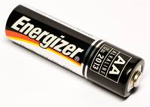
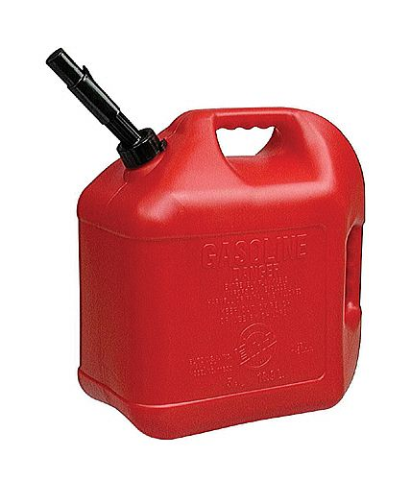
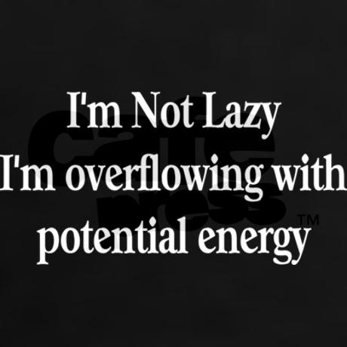
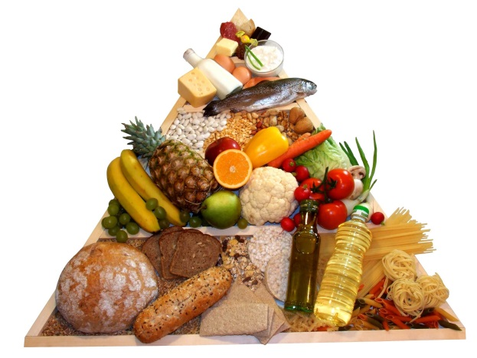
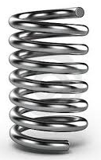
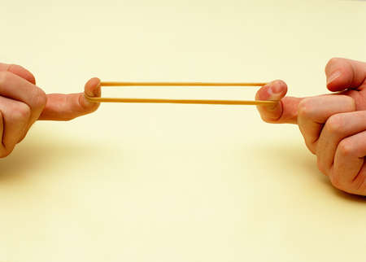
Potential Energy
Potential energy is stored energy
Types:
Elastic potential energy is stored energy by something that can stretch or compress
Ex. Rubber band
Chemical potential energy is energy stored in chemical bonds

Slide 6
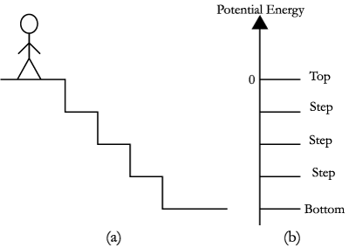
Potential Energy
Gravitational Potential Energy is energy stored by objects due to their position above Earth’s surface.
Depends on the mass and height above the ground
Gravitational potential energy (J) = mass (kg) x acceleration of gravity (m/s² ) x height (m)
GPE = mgh

Slide 7
Solve for GPE
What is the gravitational potential energy of a ceiling fan that has a mass of 7.0 kg and is 4.0 m above the ground?
M = 7.0 kg
H = 4.0 m
Acceleration of gravity is g = 9.8 m/s²
GPE = mgh
GPE = 7 x 9.8 x 4 = 274 J
DON’T FORGET YOUR UNITS

