Slide 1
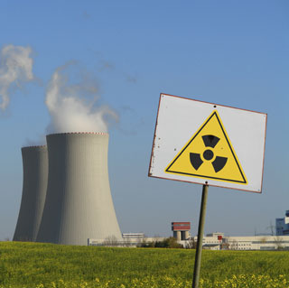
Fission and Fusion
Physical Science
Chapter 18 Section 4

Slide 2
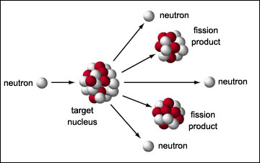
Nuclear Fission
Nuclear fission is the process of splitting a nucleus into several smaller nuclei
Fission means “to divide”
Occurs in Nuclear Power Plants

Slide 3
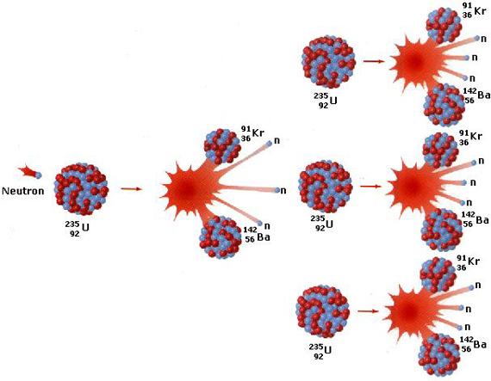
Chain reactions
neutrons are emitted during fission. These neutrons can strike other nuclei in the sample and cause them to split. Which can cause even more atoms to split
This series of repeated fission reactions caused by the release of neutrons is a chain reaction

Slide 4
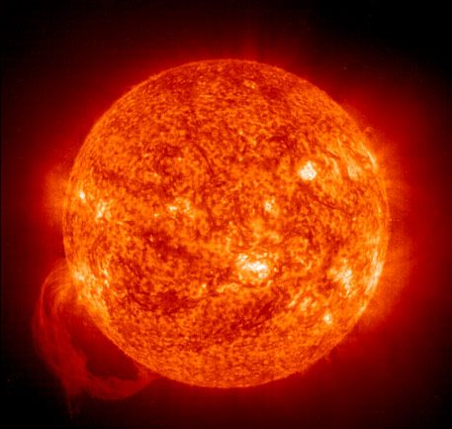
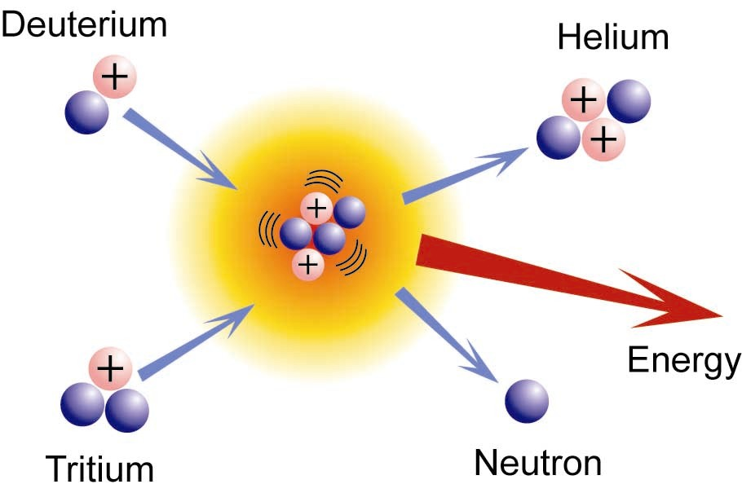
Nuclear Fusion
In nuclear fusion, two nuclei with low masses are combined to form one nucleus of larger mass
Occurs in the sun

