Slide 1
Half Life

Slide 2
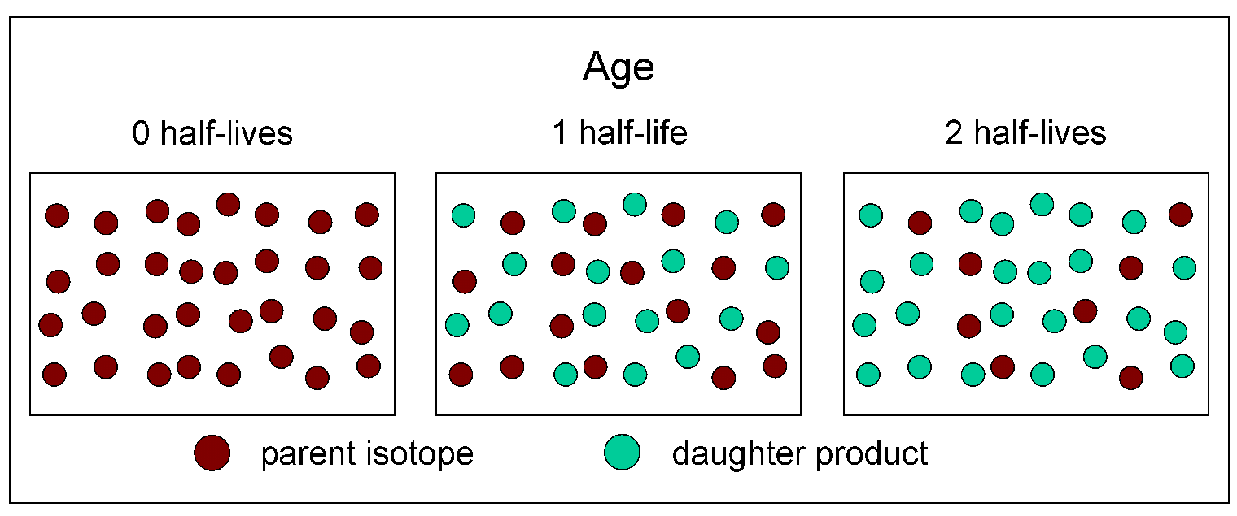
What’s half life?
The half-life of a radioactive isotope is the amount time it takes for half the nuclei in a sample of the isotope to decay

Slide 3
Half Life Analogy
You have $200 in your wallet. You go shopping and spend half of your money in 1 hour. How much do you have left?
After another hour, you spend half of your remaining money. Now how much do you have left?
After a 3rd hour of shopping you spend half of what you have left on lunch before you head home. How much money do you have now?

Slide 4
How to solve a half life problem
You have a 200 gram sample of Radon. Its half life is 4 days. How much will remain unchanged after 12 days?
Step 1) Make a list of what you know.
Starting Mass = 200 grams
Final Mass = ?????
Half life = 4 days
# of half-lives =????
Step 2) Determine what you are solving for.
“How much will remain unchanged after 12 days?” ← We are looking for how much is left or the final mass.

Slide 5
Solving a half life problem.
You have a 200 gram sample of Radon. Its half life is 4 days. How much will remain unchanged after 12 days?
Step 3) Solve using a chart.
Half life | Time passed | mass
Starting (0) | None | 200 grams
1 | 4 | 100 grams
2 | 8 | 50 grams
3 | 12 | 25 grams

Slide 6
Try this one on your own.
Polonium-209 decays from 200 grams to 12.5 grams in 8 hours. How long is one “half life”?

Slide 7
Try this one on your own.
Polonium-209 decays from 200 grams to 12.5 grams in 8 hours. How long is one “half life”?
Starting Mass = 200 grams
Final Mass = 12.5 g
Half life = ??
Time = 8 hours
# of half-lives =????
Half life | Time passed | mass
Starting (0) | None | 200 grams
1 |  | 100 grams
2 |  | 50 grams
3 |  | 25 grams
4 | 8 | 12.5 grams

Slide 8
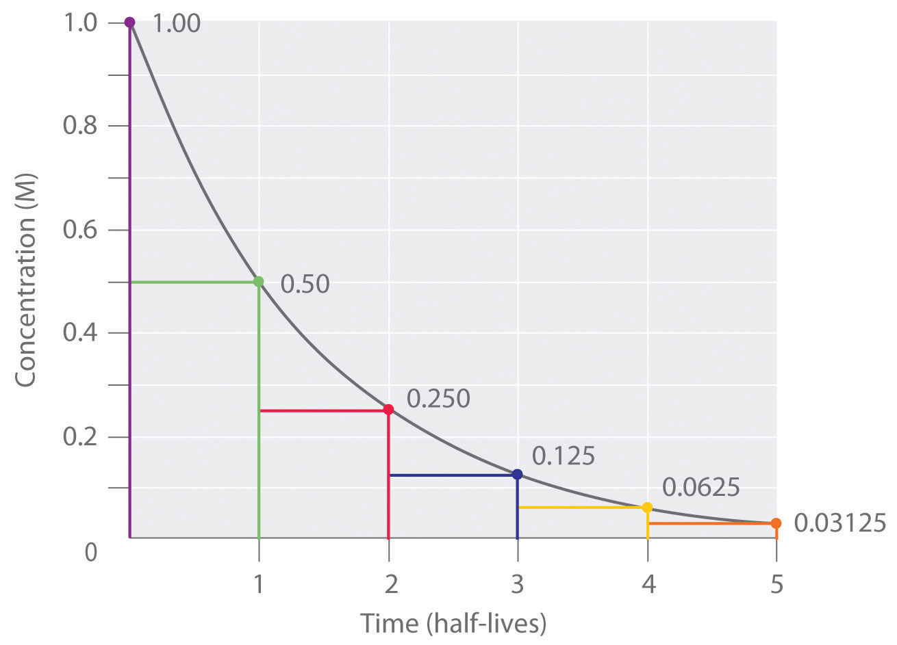
Graphing Half-Life
How much is left after 1 half life? 2 half lives?
(g)

