Slide 1
Chemical Bonds
Physical Science Chapter 20

Slide 2
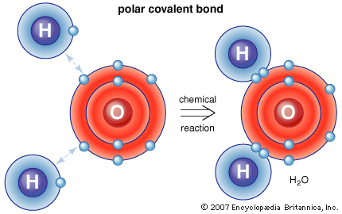
Chemical bonds
A chemical bond is the force that holds atoms together in a compound.

Slide 3
Chemical Formulas
A chemical formula tells what elements a compound contains and the exact amount of the atoms of each element in a unit of that compound
What elements and how many of each are in the following?
HCl (hydrochloric acid)
CH₃COOH (vinegar)
C₁₂H₂₂O₁₁ (sucrose)

Slide 4
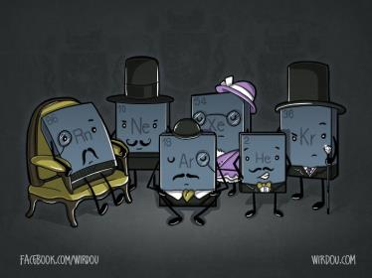
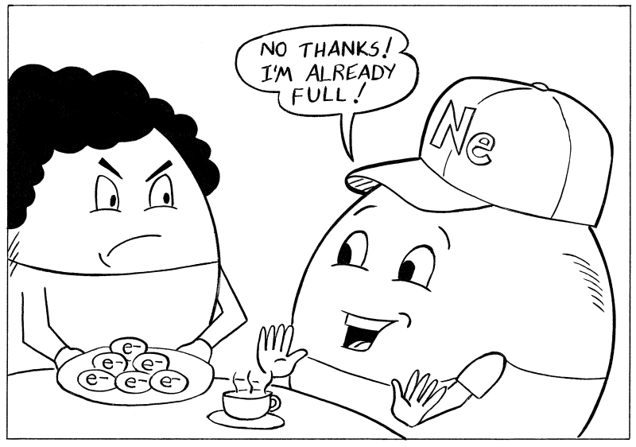
Atomic Stability
An atom is chemically stable when its outer energy level is full
Octet rule: atoms tend to gain, lose or share electrons to have eight electrons in their outer electron shell
Which group of elements already has eight electrons in their outer shell?

Slide 5
Ionic Bonds

Slide 6
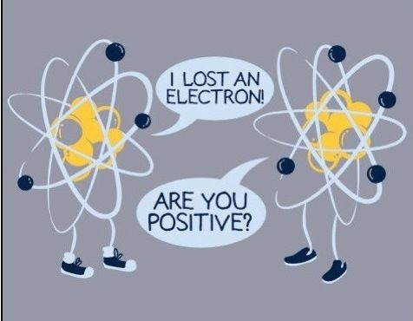
Ions
An ion is formed when an atoms gains or loses an electron.
If it gains an electron it becomes negative
If it loses an electron it becomes positive

Slide 7
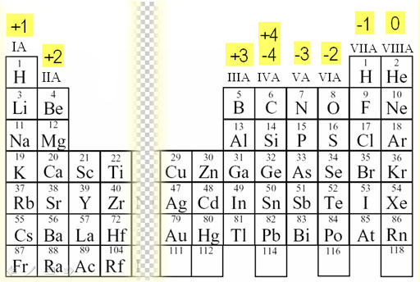
Oxidation number
Oxidation number tells you how many electrons an atom has gained, lost, or shared to become stable
Ionic compounds – same as the charge of the ion
“1 plus, 2 plus, 3 plus, SKIP, 3 minus, 2 minus, 1 minus ZIP”

Slide 8
Ionic Bond
Ionic bond is the force of attraction between the opposite charges of the ions
Forms between a metal and a nonmetal
Electrons are transferred

Slide 9
Writing Ionic Compounds
What is the chemical formula for Sodium and Oxygen?
Steps to take:
1. Determine atomic symbol and oxidation number for each element:
Sodium = Na¹⁺ Oxygen = O²⁻
2. “Swap and Drop” – The oxidation number becomes the subscript for the other element
Na¹⁺ O²⁻
Na₂ O
3. Other things to know:
Subscripts do not have a charge (so don’t write the + or -)
You do not write “1” as a subscript – it is understood that there is “1” there
If the oxidations add up to zero then you just write the symbols, no subscripts.

Slide 10
Practice
Sodium and Chlorine
Potassium and Oxygen
Calcium and Fluorine

Slide 11
Writing names of binary ionic compounds
Write the name of the positive ion
Write the root name of the negative ion. The root is the first part of the element’s name.
Example: Chlorine would be chlor-
Add the ending –ide to the root.
A few special elements:
Oxygen = oxide
Phosphorus = phosphide
Nitrogen = nitride
Sulfur = sulfide
Important note: Subscripts do not become part of the name for ionic compounds.

Slide 12
Practice Naming Ionic Compounds
NaCl
K₂0
Calcium and Fluorine
MgO

