Slide 1
EOCT Physical Science Review

Slide 2
SPS5. Students will compare and contrast the phases of matter as they relate to atomic and molecular motion.
State
Movement
Proximity
Shape/Volume
Solid
Very little; slow
Tightly packed
Definite shape and volume
Liquid
Free to move; faster
Close together
No definite shape; definite volume
Gas
Very fast
Very far apart
No definite shape; fills container

Slide 3
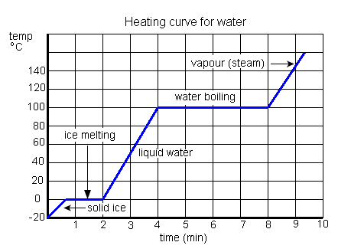
Solid Liquid Gas

Slide 4
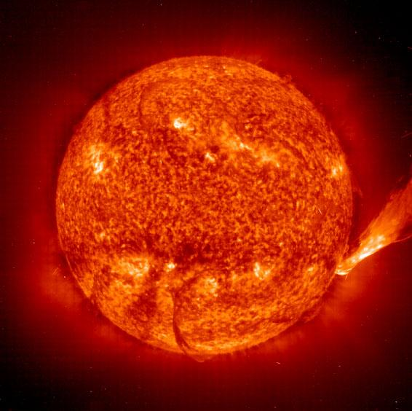
Plasma- the 4th state of matter
Plasmas consist of freely moving charged particles, i.e., electrons and ions.
Lightning creates a jagged column of plasma.
When an electric current is passed through neon gas, it produces both plasma and light.
Part of a comet's streaming tail is plasma from gas ionized by sunlight and other processes.
The Sun is a ball of plasma.

Slide 5
Matter
Element simplest form of matter; cannot be broken down, made of identical atoms
Compound a chemically combined substance made of two or more elements
Ionic bond transfer of electrons
Covalent bond sharing of electrons
Mixture different substances that are simply mixed together
Heterogeneous non uniform composition
Homogeneous uniform composition; solutions

Slide 6
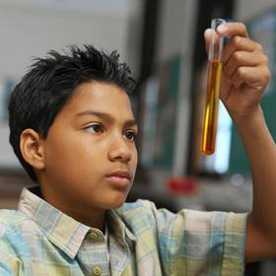
Physical and Chemical properties and changes
Physical properties are determined by observation, either looking or measuring examples color, mass, density, odor luster, malleable, ductile
Chemical Properties can only be found through testing example includes flammability

Slide 7
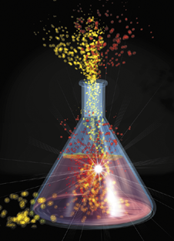
Physical and Chemical changes
Physical change original substance still exists - change in size, shape, or phase
Chemical change new substance is produced and energy always changes, can be accompanied by physical changes
Identification of a chemical change
new substances (products) are produced.
gas is formed
temperature change
precipitate forms
appearance of a new color or odor
Examples fermentation, metabolism, electrolysis.

Slide 8
Phase Changes
Phase change | What happens | Energy change
Melting | Solid becomes liquid | Absorbs heat | Endothermic
Vaporization (boiling or evaporation) | Liquid becomes gas | Absorbs heat | Endothermic
Sublimation | Solid become gas | Absorbs heat | Endothermic
Freezing | Liquid becomes solid | Releases heat | Exothermic
Condensation | Gas becomes liquid | Releases heat | Exothermic
Deposition | Gas becomes a solid | Releases heat | Exothermic

Slide 9
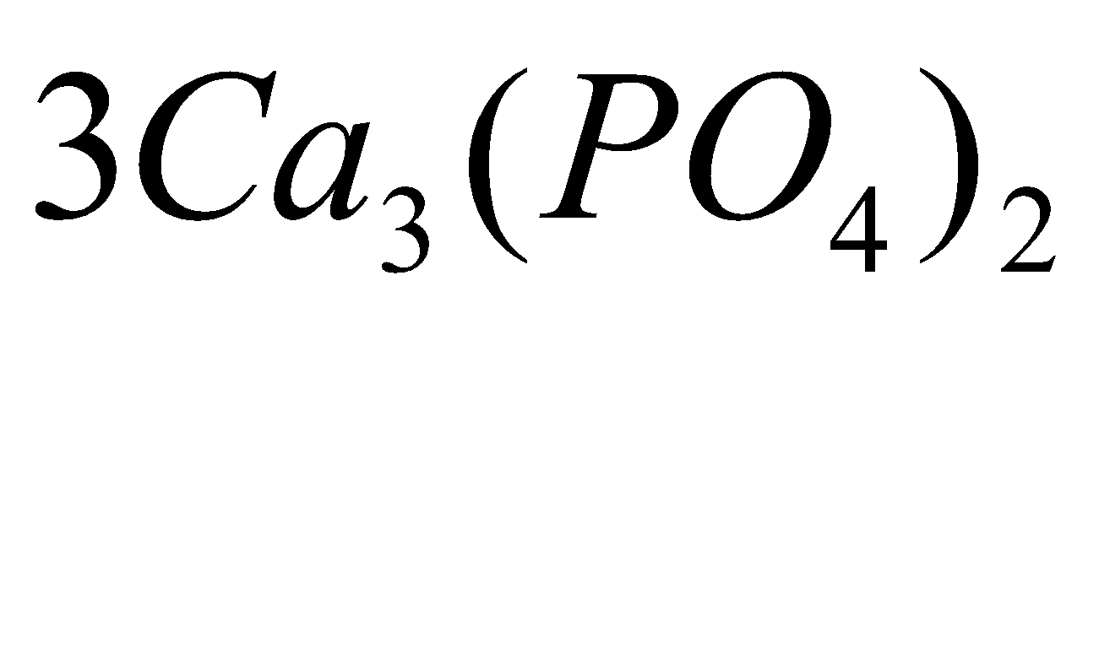
SPS2. Students will explore the nature of matter, its classifications, and its system for naming types of matter. How to read a chemical formula
What is the coefficient?
What are the subscripts?
How many oxygen atoms are there?
Cation – positively charged ion, created when an atom loses an electron
Which is the cation?
Anion – negatively charged ion, created when an atom gains an electron
Which is the anion?

Slide 10
Covalent Bonds
-Between two nonmetals.
-Formed by sharing electron pairs
-Insoluble and non-electrolytes
Examples; O₂, CO₂, C₂H₆, H₂O, SiC

Slide 11
Ionic Bonds
Between a metal and a nonmetal
Transfer of electron (s)
Soluble and Strong Electrolytes
Examples: NaCl, MgO

Slide 12
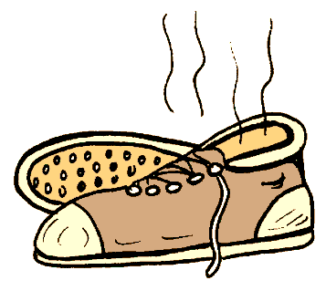
Indicators of chemical reactions
Emission of light or heat
Formation of a gas
Formation of a precipitate
Color change
Emission of odor

Slide 13
All chemical reactions:
have two parts
Reactants - the substances you start with
Products- the substances you end up with
The reactants turn into the products.
Reactants → Products

Slide 14
Types of Chemical Reactions
Synthesis A + B AB
Decomposition AB A + B
Single Replacement A + BC AC + B
Double Replacement AB + CD AD + CB

Slide 15
SPS1. Students will investigate our current understanding of the atom.
Charge
Mass
Location
protons
+1
1 amu
nucleus
neutrons
Neutral
1 amu
nucleus
electrons
-1
0
Outside nucleus in electron cloud

Slide 16
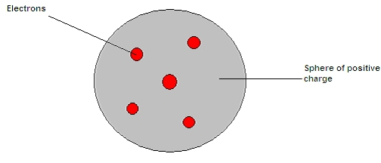
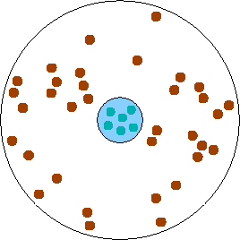
Models of the atom through history
Dalton’s Model - solid and indivisible
Thomson model – plum pudding
Rutherford gold foil experiment-the electrons orbit around the dense nucleus

Slide 17
Bohr’s Energy Levels
In the Bohr model there were distinct energy levels where electrons could exist
1st energy level holds 2 electrons
2nd energy level holds 8 electrons
3rd energy level holds 8 then 18 after 4th level gets 2 electrons.
What element is this?
Oxygen

Slide 18
Modern View of the Atom
The atom is mostly empty space
Two regions
Nucleus- protons and neutrons.
Electron cloud- region where you might find an electron.

Slide 19
Atomic Number
The number of protons in an atom of a particular element is its atomic number
Each element has a different atomic number

Slide 20
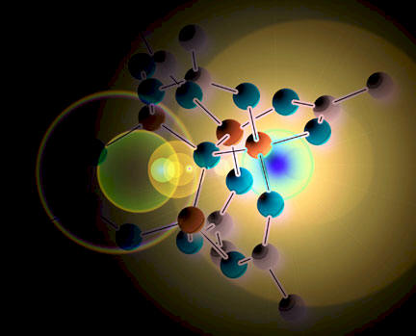
Atomic Mass
Protons and neutrons are responsible for most of the atomic mass of an atom
The number of protons and neutrons in an atom are the mass number of that atom

Slide 21
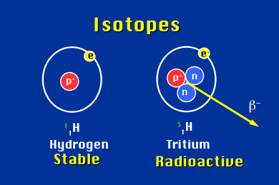
Isotopes
For any given element, all nuclei have the same number of protons, but the number of neutrons may vary.
These atoms of the same element with different atomic masses are called isotopes.

Slide 22
SPS4. Students will investigate the arrangement of the Periodic Table

Slide 23
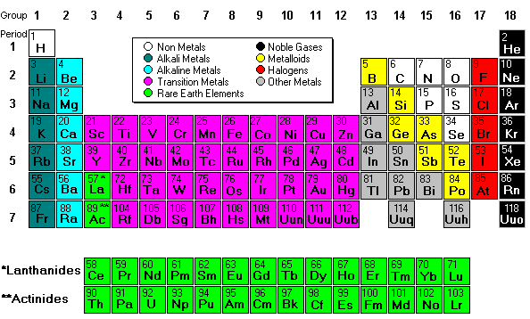
Remember to use the Periodic Table provided on the Test

Slide 24
Periods are the rows

Slide 25
9____
F
Fluorine
18.998
2,7
Atomic Number
Atomic Symbol
Element name
Atomic Mass
# of electrons per level

Slide 26
SPS6. Students will investigate the properties of solutions.
A solution is a homogeneous mixture composed of a solute and a solvent.
A solute is the dissolved substance in a solution. There is less of it.
salt in salt water
sugar in soda
carbon dioxide in soda
A solvent is the dissolving medium. You have more of it.
water in salt water
water in sodas

Slide 27
Dilute vs Concentrated

Slide 28
Saturation of Solutions

Slide 29
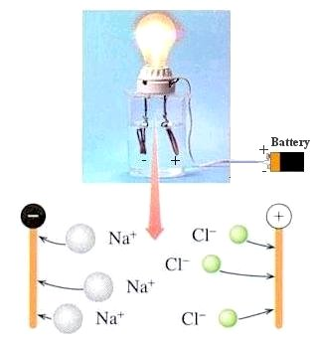
Conductivity of Solutions
Electrolytes - substances whose water solution conducts electricity
ionic compounds such as NaCl
acids and bases such as HCl (hydrochloric acid) and NaOH (sodium hydroxide)
Non electrolytes - substances whose aqueous solutions do not contain ions and do not conduct an electrical current.

Slide 30
SPS3. Students will distinguish the characteristics and components of radioactivity. Radioactive Decay Alpha Particle – Helium nucleus Beta Particle – electron Gamma Ray – high-energy photon Half Life Amount of time it takes for one half of a sample of radioactive atoms to decay

Slide 31
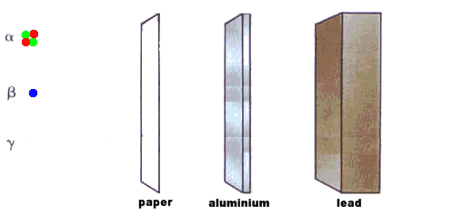
Radiation
Alpha
Beta
Gamma

Slide 32
Explain the process of half-life as related to radioactive decay
The time it takes for half of a radioactive element to decay is its half-life.

Slide 33
Half Life Calculation
You have 400 mg of a radioisotope with a half-life of 5 minutes. How much will be left after 30 minutes?

Slide 34
Physics Review

Slide 35
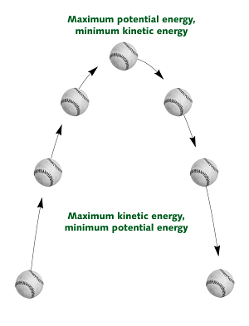
SPS7. Students will relate transformations and flow of energy within a system States of Energy
The most common energy conversion is the conversion between potential and kinetic energy.
All forms of energy can be in either of two states:
Potential - stored
Kinetic - motion

Slide 36
Energy
Law of Conservation of Energy – energy cannot be created or destroyed
Energy can be defined as the ability to do work.
Because of the direct connection between energy and work, energy is measured in the same unit as work: joules (J).
In addition to using energy to do work, objects gain energy because work is being done on them.

Slide 37
Forms of Energy
The five main forms of energy are:
Thermal
Chemical
Electromagnetic
Nuclear
Mechanical

Slide 38
Thermal & Chemical Energy
The molecular motion of the atoms is called thermal energy
Thermal energy can be produced by friction
Thermal energy causes changes in temperature and phase of any form of matter
Examples : solar & geothermal
Chemical energy is required to bond atoms together.
And when bonds are broken, energy is released.
Examples: biomass

Slide 39
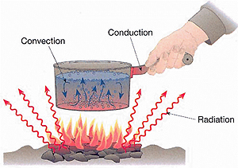
Heat Transfer
Convection movement of gas or liquid particles spreads heat
Conduction
heat is transferred by particles touching
Radiation
heat is transferred in matter or space by means of electromagnetic waves

Slide 40
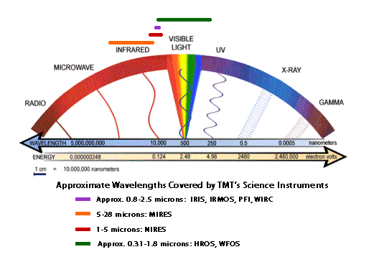
Electromagnetic Energy
Light is a form of electromagnetic energy
Each color of light (Roy G Biv) represents a different amount of electromagnetic energy
Electromagnetic Energy is also carried by X-rays, radio waves, and laser light
Examples: solar

Slide 41
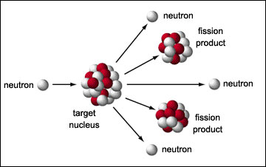
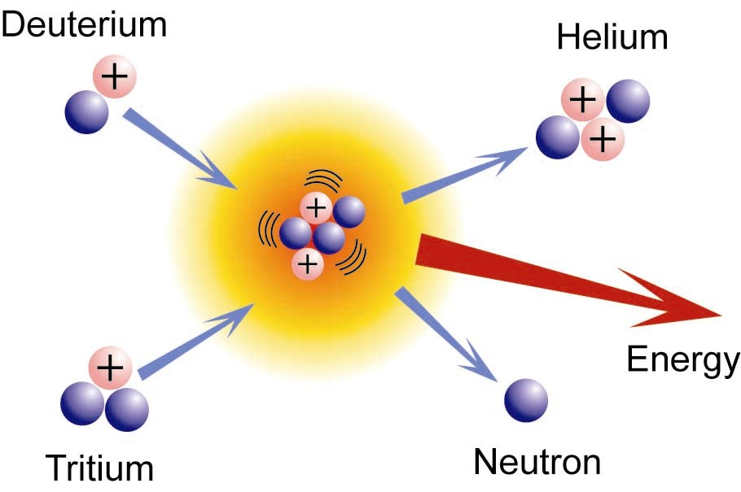
Nuclear Energy
Fission
the splitting of the atomic nucleus
Examples: nuclear power plant
Fusion
light nuclei fuse or combine
Example: Nuclear Power Plants

Slide 42
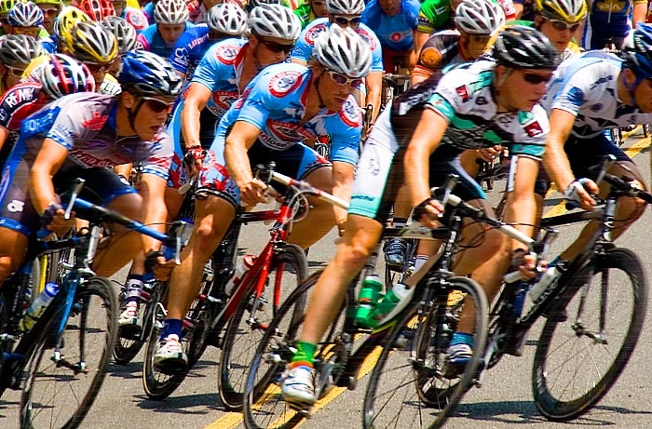
Mechanical Energy
When work is done to an object, it acquires energy. The energy it acquires is known as mechanical energy
Examples: wind, hydroelectric

Slide 43
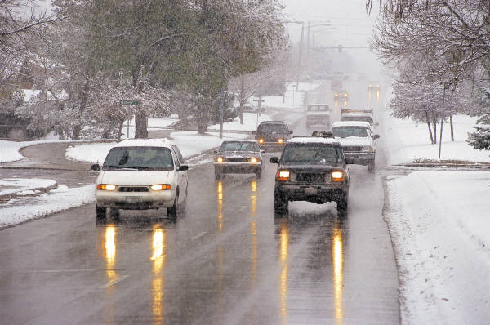
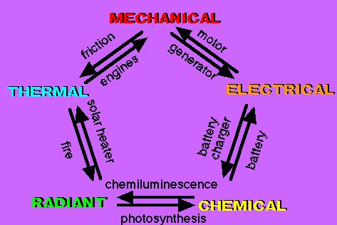
Energy conversions
All forms of energy can be converted into other forms.
Chemical → Heat →Mechanical

Slide 44
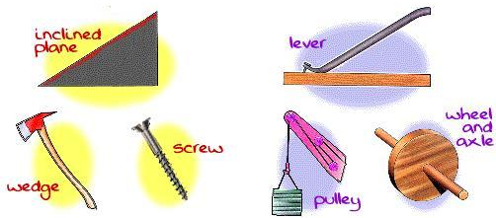
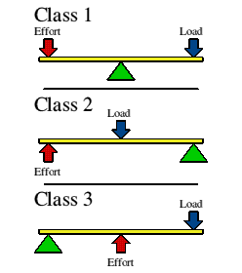
S8. Students will determine relationships among force, mass, and motion. Simple machines
inclined plane - ramp, stairs
wedge – two inclined planes screwdriver, knife, axe
screw – inclined plane wrapped around a cylinder
pulley – revolution around a fixed point; more pulleys easier work
lever – has a fulcrum like a see-saw
wheel and axle – bicycle, car, doorknob

Slide 45
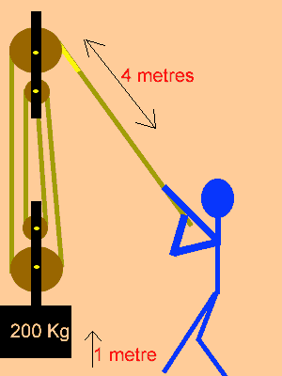
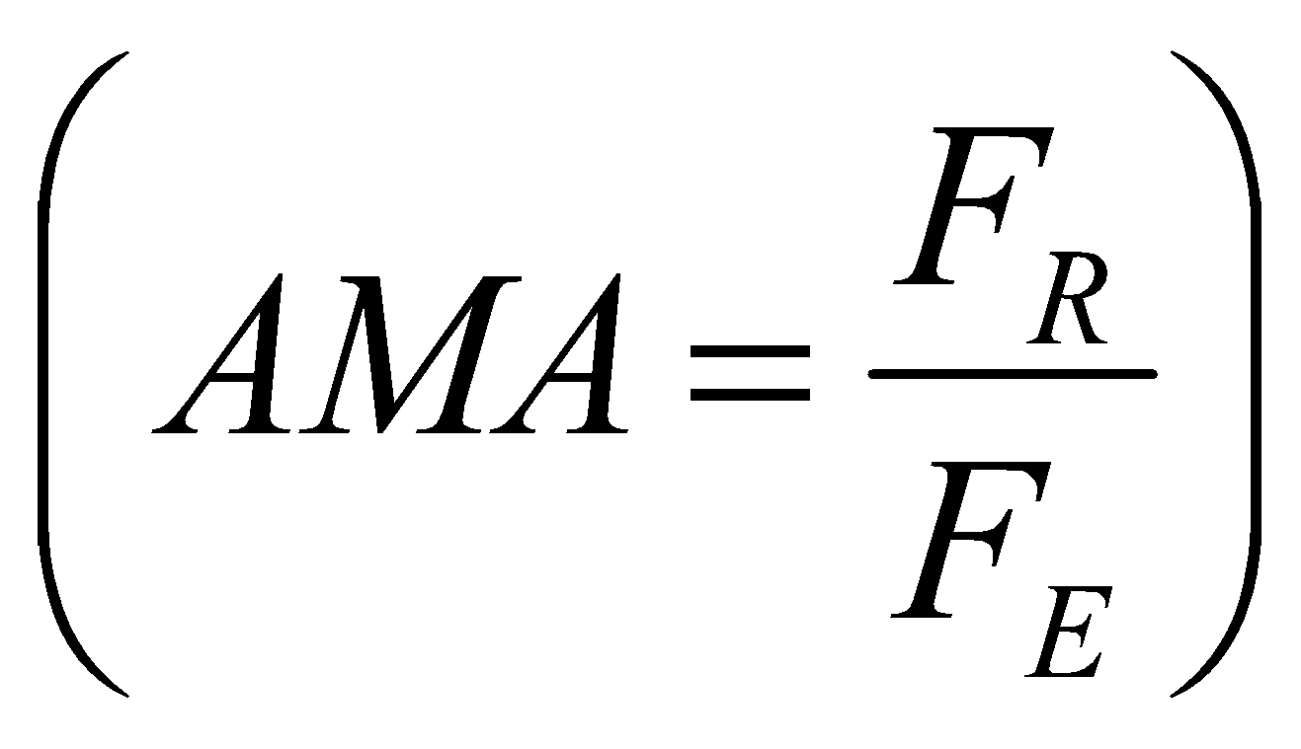
Mechanical Advantage
Mechanical Advantage-the number of times a machine multiplies an effort force
Actual Mechanical Advantage:

Slide 46
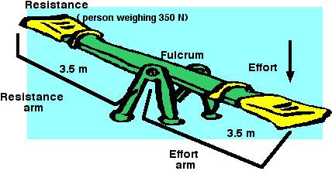
Ideal Mechanical Advantage
Ideal means no friction – not possible in reality!
IMA= Effort Length
Resistance Length
F_{R} is Force due to resistance and
F_{E} is Force due to effort

Slide 47
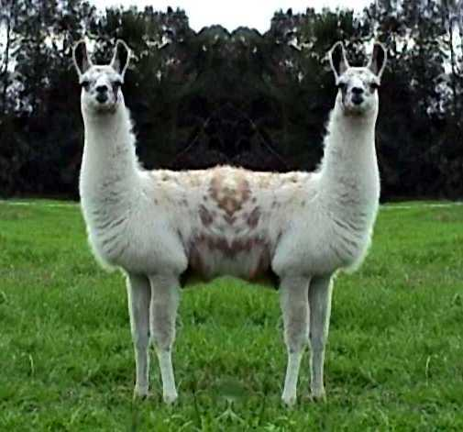
Force
A push or pull
Measured in Newtons
An object at rest and an object moving at a constant velocity is being acted upon by a net force of zero

Slide 48
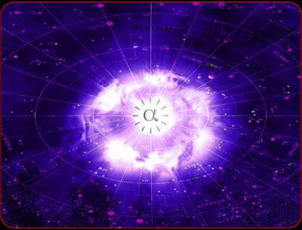
Force
4 fundamental forces
Gravitational attraction between two objects, depends on masses and distance between them
Electromagnetic - force exerted on a charged particle in an electromagnetic field
Strong nuclear force – holds the nucleus together by the exchange of mesons
Weak nuclear force – allows for radioactive decay, particularly beta

Slide 49
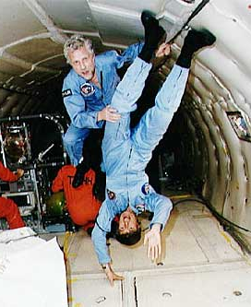
Mass vs. Weight
Mass—the amount of matter in an object
Weight—the force on a body due to the gravitational attraction of another body
Weight changes based on location.
Mass NEVER changes.

Slide 50
Newton’s 1st Law of Motion
An object in motion will stay in motion and an object at rest will stay at rest unless acted upon by an unbalanced force
Law of Inertia—why we wear seat belts.

Slide 51
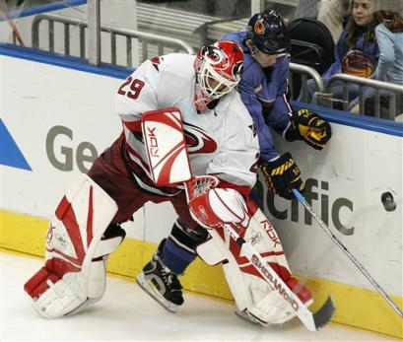
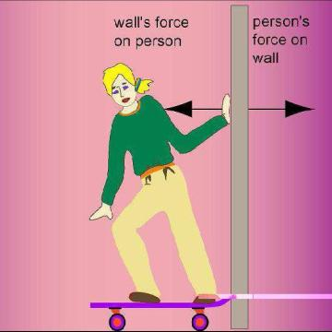
Newton’s 2nd & 3rd Laws of Motion
F = ma
For every action there is an
equal and opposite reaction

Slide 52
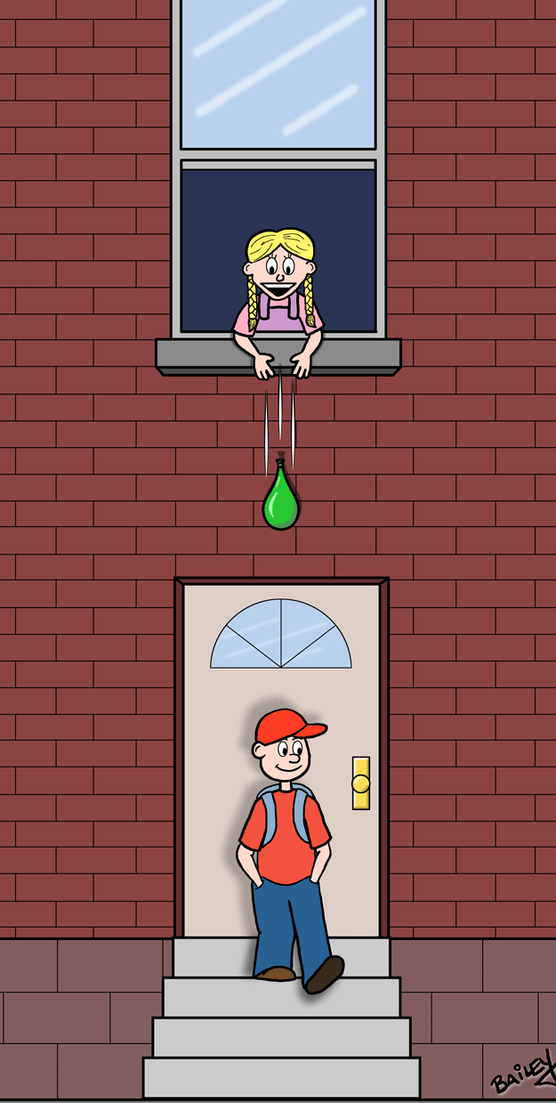
Acceleration due to Gravity
On Earth, all objects fall with a constant acceleration of about 10 m/s² in the absence of air resistance.
In other words, a falling object’s velocity increases by 10 m/s each second it falls!

Slide 53
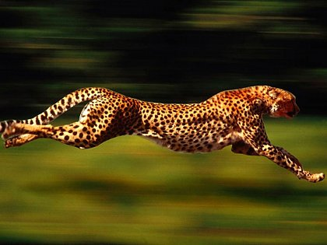
Displacement, Velocity & Acceleration
Displacement vs. distance - displacement has a direction
Velocity vs. speed – velocity has a direction
Velocity = displacement
time
Acceleration - rate at which velocity changes
Acceleration = final velocity – initial velocity
time
Is acceleration directional?

Slide 54
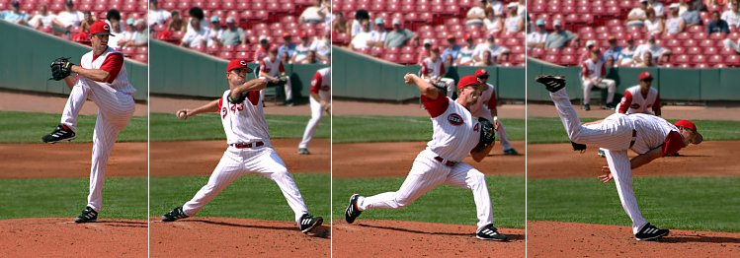
Work
Work = Force x Distance
Measured in Newton-meters or Joules
No movement means NO
work being done.
The pitcher does positive work on the ball by transferring energy into it. The pitcher does negative work on it.

Slide 55
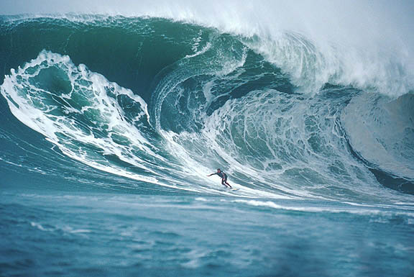
SPS9. Students will investigate the properties waves. Waves
A disturbance that transmits energy through a medium or space

Slide 56
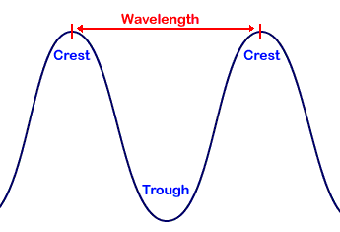
Wave Properties
Wavelength - the distance between peak to peak , shorter wavelengths = higher frequency
Amplitude- the maximum displacement
Amplitude is related to intensity, higher the amplitude the higher the intensity (energy). For sound it means greater volume.
Velocity = frequency x wavelength
Amplitude

Slide 57
Frequency
The number of events (waves, vibrations, oscillations) that pass a point in a given amount of time, usually a second
High frequency (short wavelength)
Low frequency
(long wave-length)
Frequency is related to pitch, the higher the frequency the higher the pitch

Slide 58
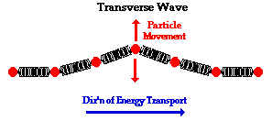
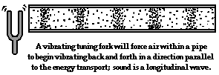
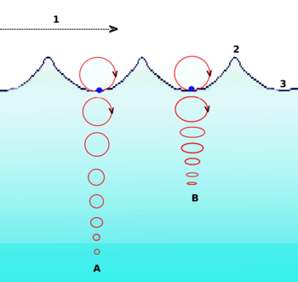
Types of waves
Transverse - particles of the medium move perpendicular to the direction of the wave
example –wave on string
Longitudinal - particles move parallel to the direction of the wave example - sound
Surface - particles move in
circular motion - longitudinal and transverse examples-Seismic and water waves

Slide 59
Electromagnetic Spectrum
EM waves do not require a medium
Energy increases with frequency and amplitude

Slide 60
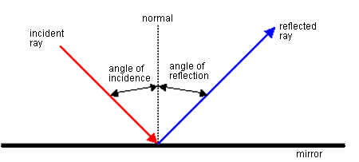
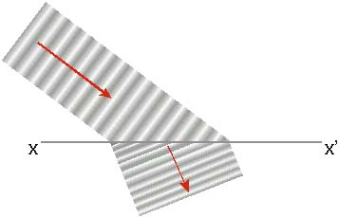
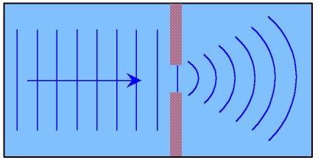
Behaviors of Waves
Reflection—wave bounces off barrier
Refraction—wave changes direction as it moves from one medium to another
Diffraction—the bending of a wave around a barrier

Slide 61
When light goes from air to water, it’s speed slows down and refraction occurs.

Slide 62
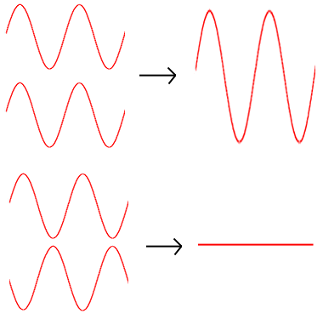
Interference
Constructive occurs when two waves disturb the medium in the same way. The disturbance is larger than the disturbance of either wave separately
Destructive is canceling interference that occurs when two waves disturb the medium in opposite ways. The disturbance is smaller than the disturbance of either wave separately

Slide 63
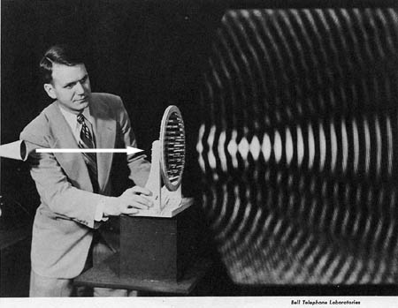
Mechanical Waves
Require a medium
Sound is an example of a mechanical wave
Sound travels best in denser materials and higher temperatures
Earthquakes
Ocean waves

Slide 64
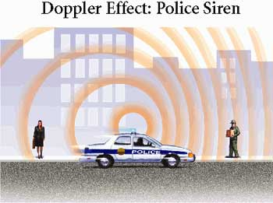
Doppler Effect
As a sound source moves toward a listener, the pitch seems to increase
As the sound source moves away from the listener, the pitch seems to decrease

Slide 65
Sound travels faster in solids, then liquids, then warm air and then cold air.

Slide 66
EM waves and mirrors
CONCAVE
CONVEX
Mirrors that are indented
Objects appear larger than actual size
Mirrors that bulge out
Object appears smaller than actual size

Slide 67
EM waves and lenses
CONVEX
CONCAVE
Refracts the light that passes through it
Light rays converge
Image can be smaller or larger depending on distance of object from lense
Image can be upright or upside down depending on distance of object from lense
Refracts the light that passes through it
Light rays diverge
Image is virtual, upright and smaller

Slide 68
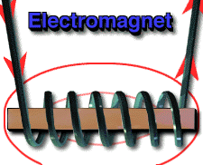
SPS10. Students will investigate the properties of electricity and magnetism. Electromagnet
To increase the strength of an electromagnet
Increase the number of coils
Increase the number of batteries

Slide 69
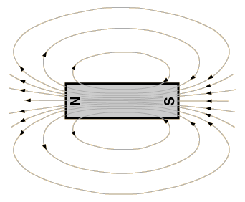
Magnetic field
Magnetic field is strongest where the lines are closest together
If you break the magnet, north and south poles will reform on each piece

Slide 70
Electricity
The movement of electrons in response to a field --- Electricity!
The electromagnetic force is one of the 4 forces of nature and is described by Coulomb’s Law

Slide 71
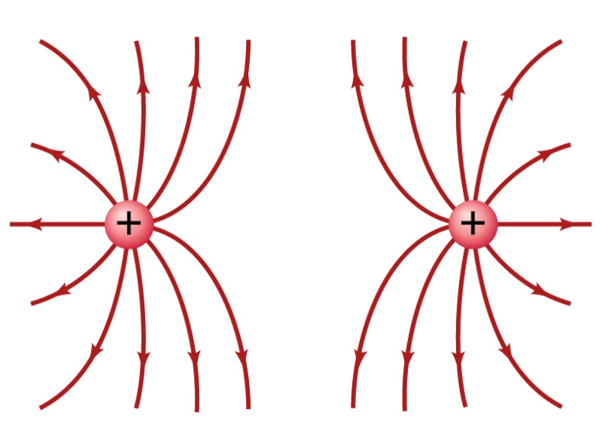
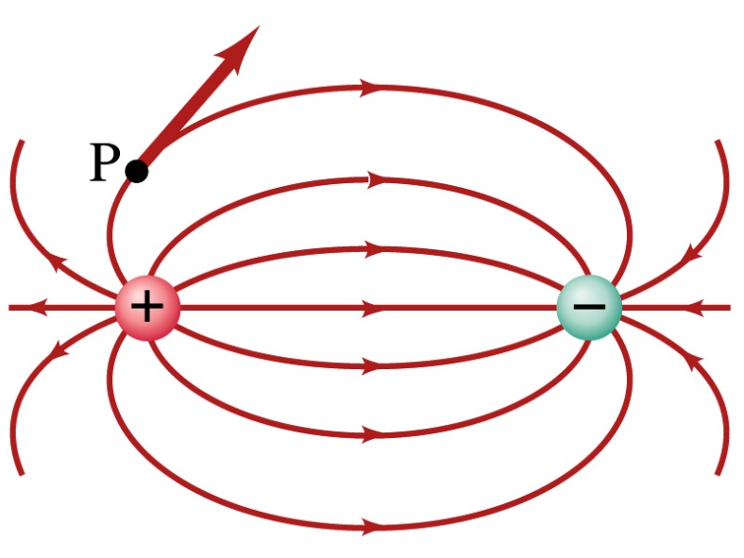
Electrical charges
Charged particles exert forces on each other
Like repels, opposites attract
The greater the distance between the charges the smaller the force

Slide 72
Static electricity
Static electricity is the charge that stays on an object – does not move
It can be positive or negative
It can be generated by rubbing two objects together (friction) and removing “loose” electrons.

Slide 73
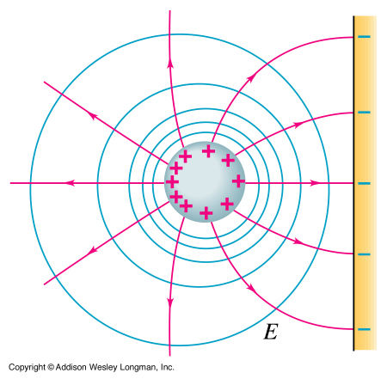
Electrical charge generation
Induction - charge can be generated by bringing a charged object close to another one
Conduction – charge can be generated by touching a charged object to another object

Slide 74
Electric Circuits
Electricity is like water flowing through pipes
Charge flows when there is a difference in potential
Current (I) – flow rate (amperes)
Resistance (R) – drag (ohms)
Voltage (V) – force or pressure (volts)

Slide 75
Ohm’s Law
V=IR Voltage = Current X Resistance
SI units
V = volt = 1 joule/1 coulomb
I = ampere = 1 coulomb/ second
R = ohm = 1 volt/amp

Slide 76
Series circuit
Series Circuit: the components are lined up along one path. If the circuit is broken, all components turn off.
R = R1 + R2 + R3 + R4

Slide 77
Parallel Circuits
Parallel Circuit – there are several branching paths to the components. If the circuit is broken at any one branch, only the components on that branch will turn off.
1/R = 1/R1 + 1/R2 + 1/R3

Slide 78
Relate magnetism and electricity
Electromagnet - Magnets can be created by wrapping a wire around an iron core and passing current through it
Electromagnetic induction - Create an electric current by moving a magnet through a coil of wire ( generator)

Slide 79
What ‘s the difference between a Motor and a Generator?
Generator – converts mechanical energy to electrical energy example – water turns a turbine, spins a magnet inside a coil to generate electricity
Motor - converts electrical energy into mechanical energy example – electricity from your car battery turns a motor which drives your wiper blades back and forth

Slide 80
Electromagnets and uses
Radios
Electric motors
Generators
Transformers
Loud speakers
Simple Radio Transmitter

