Slide 1
Thermal Energy

Slide 2
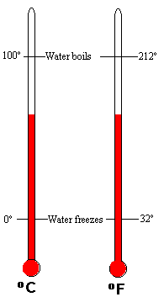
Temperature
Temperature: is the measure of the average kinetic energy of the particles in an object.
Units for Temperature: Kelvin (K), Fahrenheit (°F) , Celsius (°C)
Heat is thermal energy that flows from one object with a higher temperature to another of a lower temperature.

Slide 3
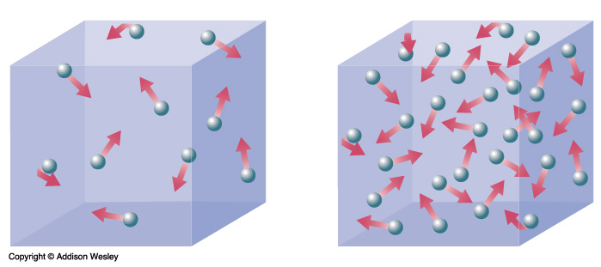
Thermal Energy
Thermal Energy: is the sum of all the kinetic and potential energy of all the particles in an object.
How are thermal energy and temperature related?
Kinetic energy increases as temp. increases
Therefore, a rise in temp. would also cause a rise in thermal energy

Slide 4
Thermodynamics
Thermal energy, heat, and work are related and the study of the relationship among them is called thermodynamics.
1st Law of Thermodynamics - the thermal energy of a system equals the work done plus the heat transferred.
2nd Law of Thermodynamics - heat cannot flow from a cooler object to a warmer object without work being done.

Slide 5
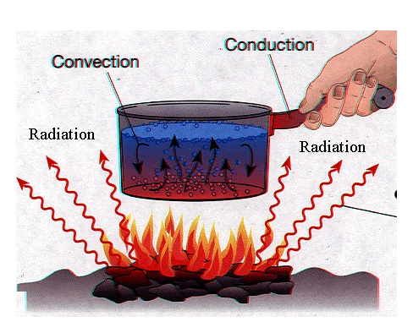
Heat Transfer
Conduction - is the transfer of thermal energy by collisions between particles in matter.
Radiation - is the transfer of energy by electromagnetic waves. When radiation strikes a material, some of the energy is absorbed, some is reflected, and some is transmitted through the material.
Convection - is the transfer of thermal energy in a fluid by the movement of warmer and cooler fluid from place to place. This is accomplished through currents.

Slide 6
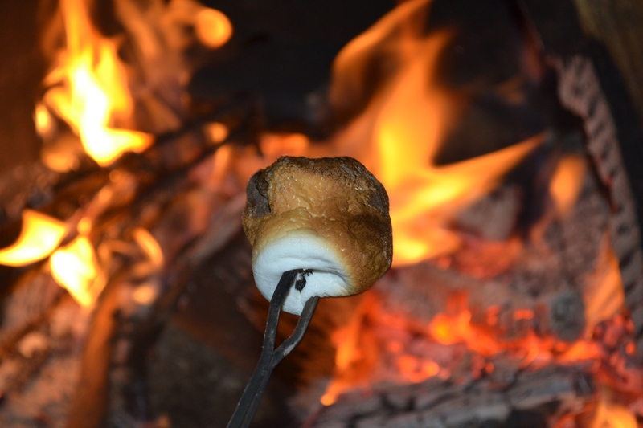
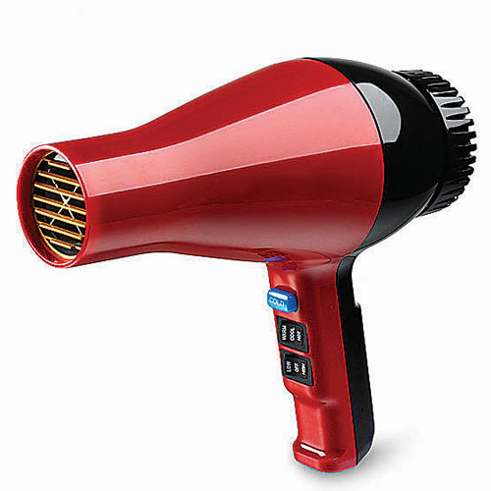
Check for Understanding
1. What type of heat transfer are the following: 2. How are heat and temperature related?

Slide 7
Solving for Specific Heat

Slide 8
Solving for Specific Heat
Specific Heat Is the amount of heat that is needed to raise 1 kg of a substance by 1ºC.
Specific heat is measured in joules/kilogram degree Celsius (J/(KgºC)
Variables: Q = Change in thermal energy (J)
m = mass (kg)
T = change in temperature (ºC)
C = specific heat ^{J}/_{kg}º_{C}
Equation: Q = (m )( ΔT)(C)

Slide 9
Practice Problem #1
A wooden block has a mass of 20 kg and a specific heat of 1,700 J/ (kg * ºC). Find the change in thermal energy of the block as it warms from 15ºC to 25ºC.

Slide 10
Practice Problem #2
Calculate the specific heat of a metal if 0.5 kg of the metal absorbs 9,000 J of heat as it warms by 10ºC.

