Slide 1
Work and Machines
Physical Science
Chapter 5

Slide 2
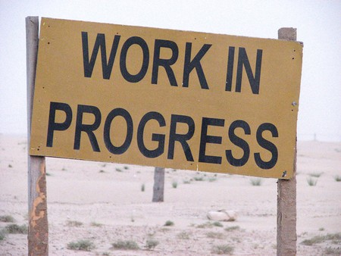
What is work?
Work: is the transfer of energy that occurs when a force makes an object move.
Conditions that must be met for work to occur:
The applied force must make the object move
The movement must be in the same direction as the applied force

Slide 3
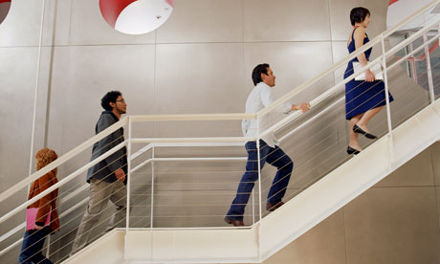
Work and Energy
How are work and energy related?
When work is done, a transfer of energy always occurs

Slide 4
Calculating Work
The amount of work done depends on the amount of force exerted and the distance over which the force is applied.
Work (in joules) = applied force (in newtons) x distance (in meters)
W = Fd

Slide 5
Example Problem
You push a box with a force of 100 N. If you move the box a distance of 5 m while you are pushing, how much work do you do?
List what you know and what you want to solve for:
F = 100 N
D = 5 m
W = ???
Formula: W=Fd
Substitute: W = 100 x 5 = 500
Units: units of work is in joules
Answer: 500 J

Slide 6
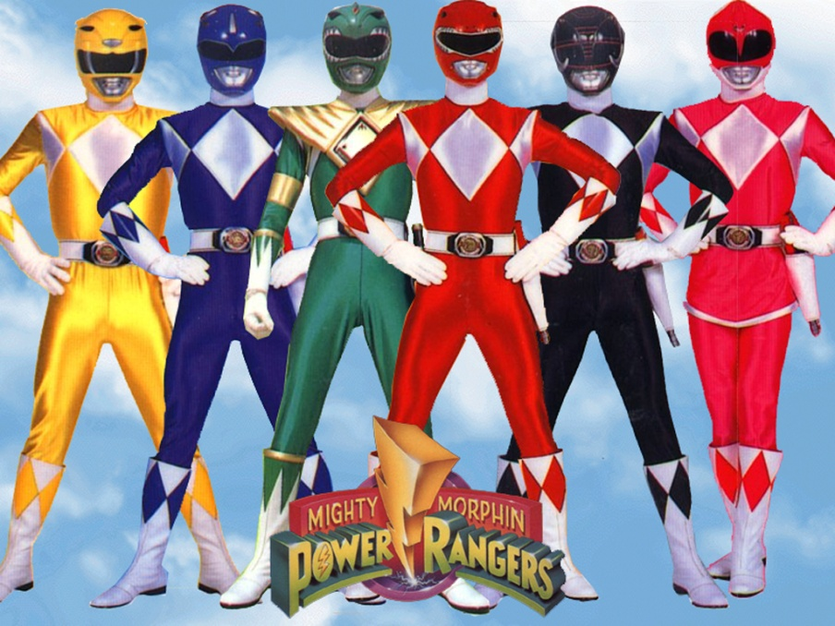
Power
Power: power is the rate at which work is done
Unit for Power is watts
Power (watts) = work (joules) / time (seconds)
P = W/t

Slide 7
Example Problem
You do 900 J of work in pushing a sofa. If it took 5 s to move the sofa, how much power did you use?
List what you know and what you are solving for:
W = 900 J
T = 5 s
P = ???
Formula: P = W/t
Substitute: P = 900/5 = 180
Units: Unit for power is in watts
Answer: 180 watts (180 W)

